Slide 1
Tacoma Tune Build

Slide 2
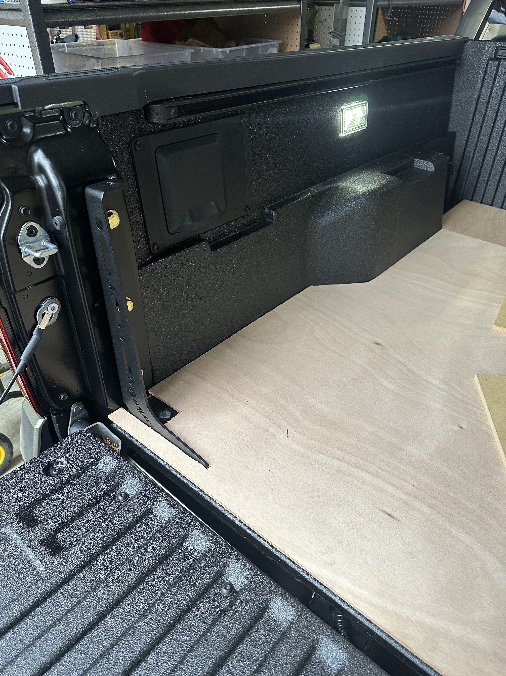
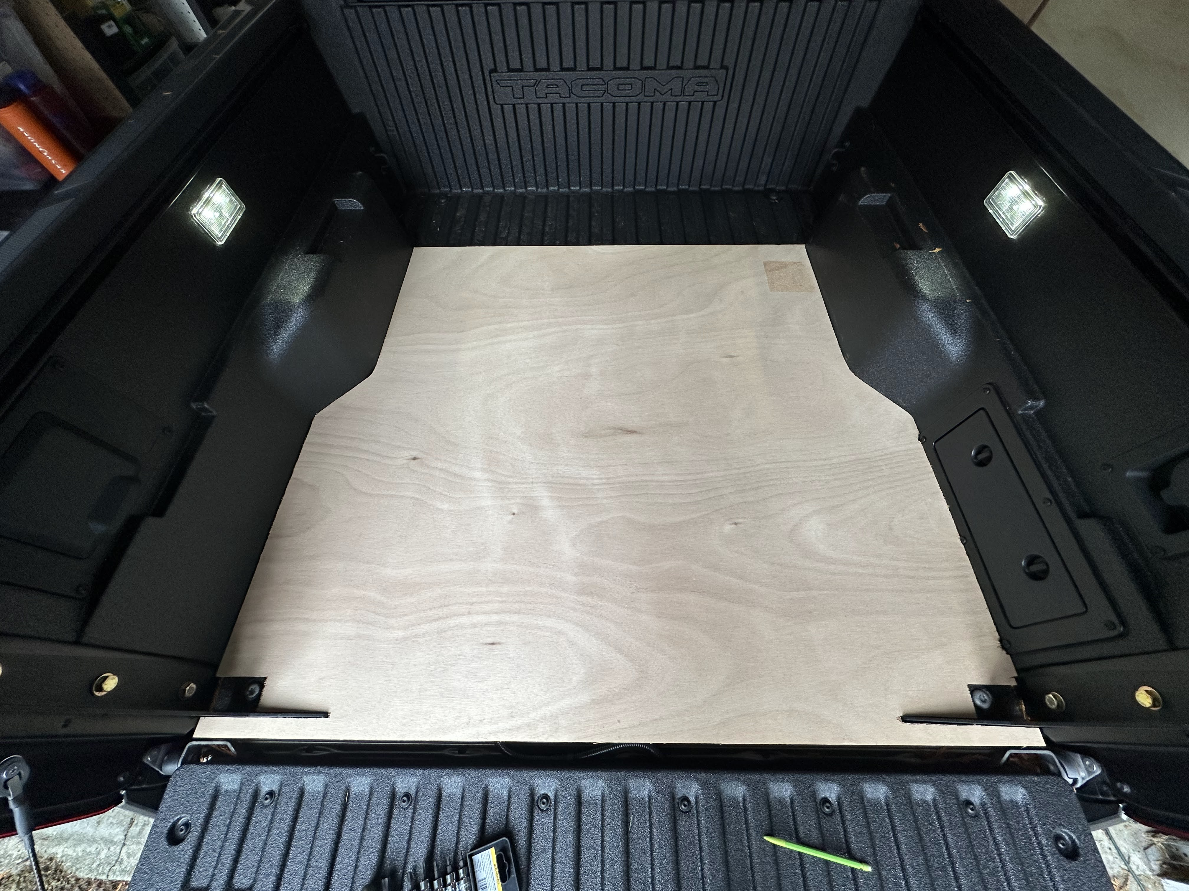
48 x 45.2
Flooring, board is 98” x 48”
52.8 W x 48 H

Slide 3
Stove
Sink
Fridge
Drawer
Sink cutout
SOK 280
Seat
Inverter
Aqua 7 Gal
Aqua 7 Gal
Short Drawer
Drawer
Seat
Short Drawer
Aqua 7 Gal
Table 31X24
Sink
Keyboard
Sink cutout
Down opening door (chips/etc)
Down opening door (chips/etc)
F C
Fridge
Seat
F C

Slide 4
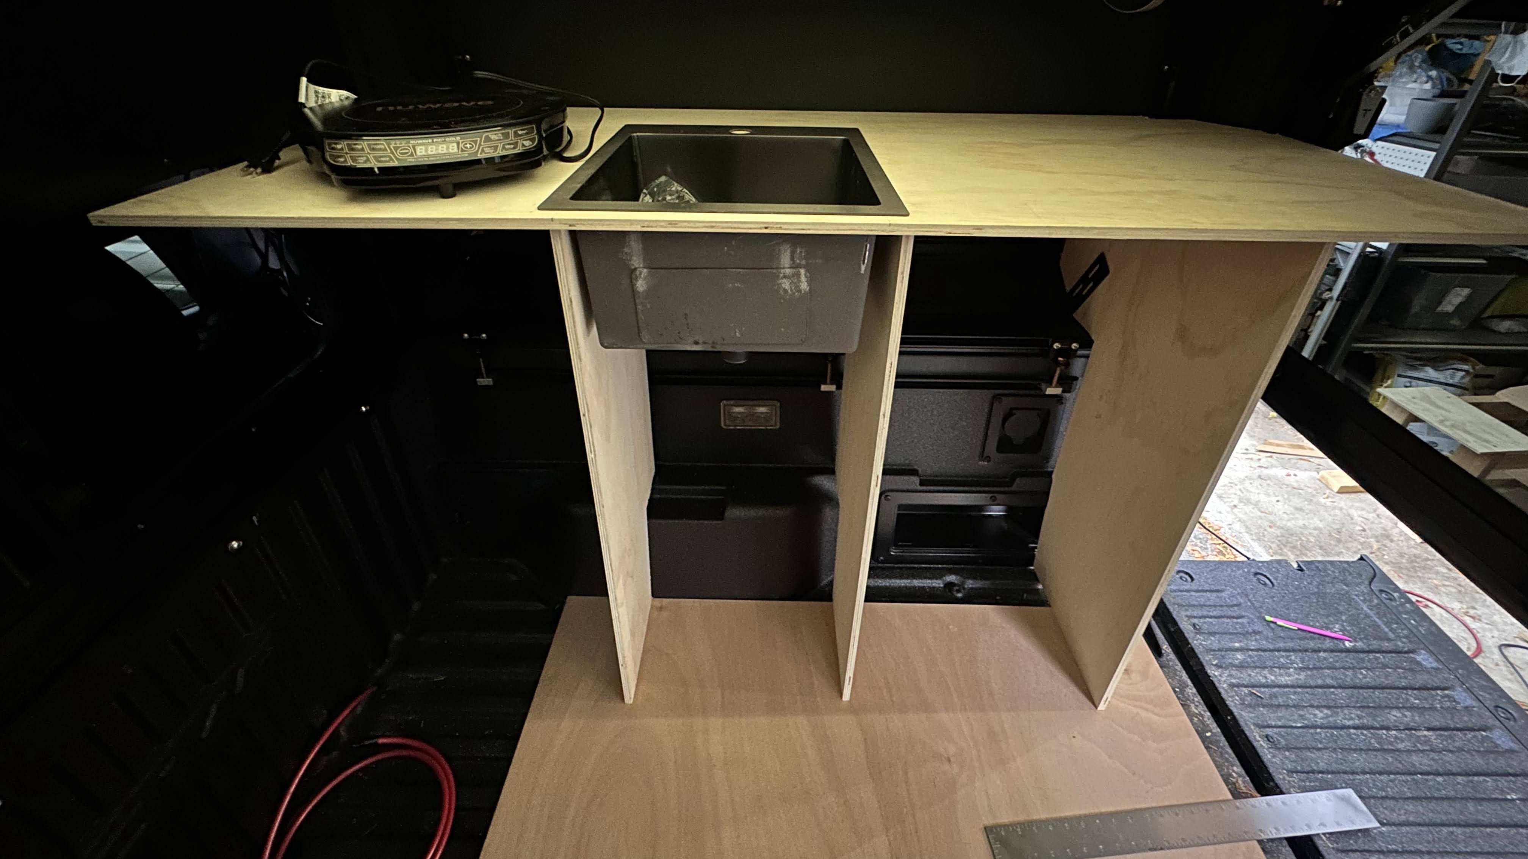
Fridge bolts in to left side
17 5/8
14.125
17.25 + a hair
1.5 x 17.25 + a hair
2 X 17.25 + a hair
2 X 17 5/8
2 X 14.125
2 X 17.25 + a hair
1.5 x ?
1.5 x 17.25 + a hair
2 x ?
2 x 17.25 + a hair

Slide 5
Table USB ports
Chassis
Battery
50A
X
DC-DC
Inverter
50A
Starter
Solar
50A
Solar Circuit Breaker

Slide 6
100
100
Induction
Battery
250A
125A
Heated Blanket
Circuit Breaker
12V Fuse Block
Inverter
15A
12A
120V
Dual
Outlet
12A
Fridge
10A
10A
65
65
10A
Lights
20A
7.5A
Dual outlet case Surface Mount Round Outlet - Dual – Teralume Industries
15A
Water pump
Inflator

Slide 7
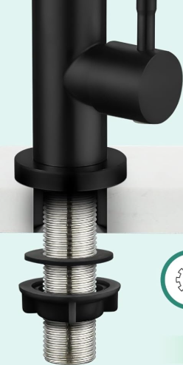
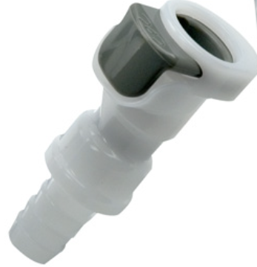
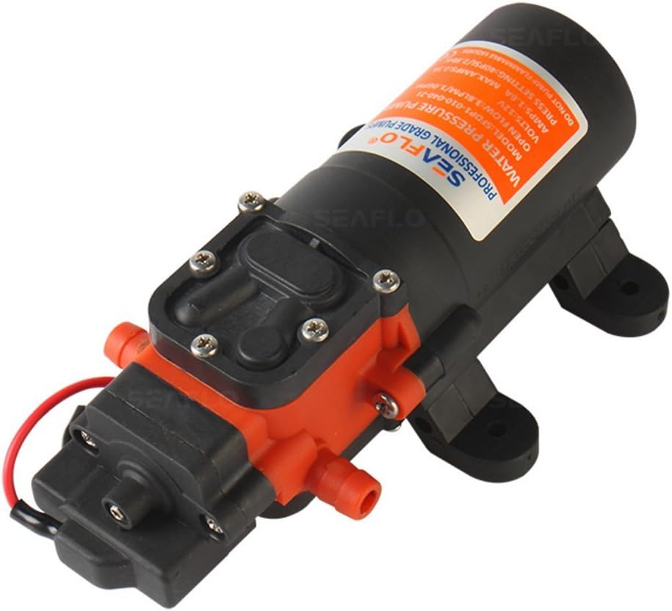
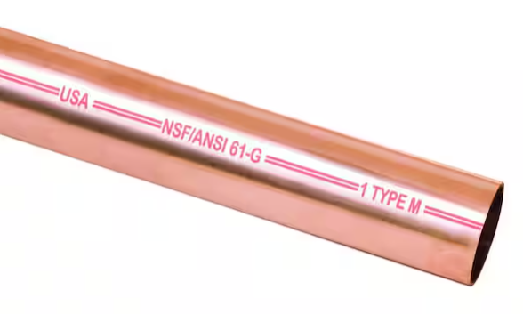
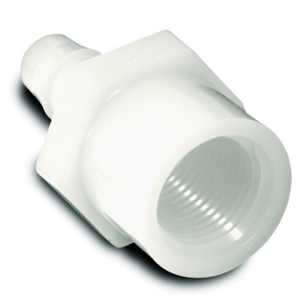
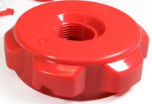
*not to scale
(6)
(7)
(5)
(1)
(10)
(1)
(9)
(2)
(4)
(1)
(8)
(3)

Slide 8
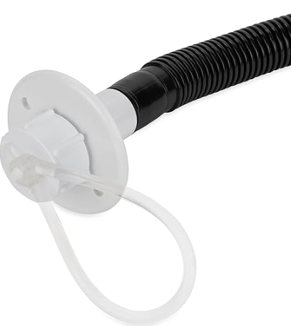
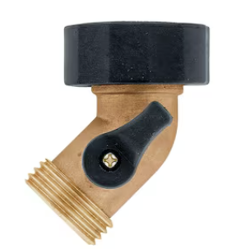
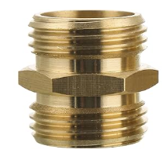
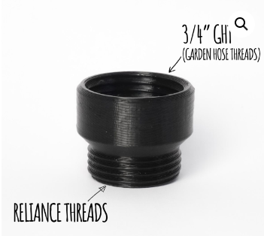
OFF
Disconnect
Drips when disconnect: None
Lid weirdness: None (straight up)
Height: Worse

Slide 9
BougeRV Arch 200W
BougeRV Arch 200W
600w, $720
Fan overlay
Fan cutout
BougeRV Arch 200W
20V, 36A
20V, 24A

